Slide 1

Understanding Your Transcript

Slide 2
Understanding Your Transcript
Student will have an official high school transcript at the end of 1st semester (9th grade)
All courses 1st semester=.5 credit (exception-college courses)
All courses 2nd semester=.5 credit
Up to 32 credits can be earned over 4 years
24 required credits to graduate
Cumulative Weighted GPA & Ranking
Cumulative Unweighted GPA & Ranking
Honors courses are not weighted
AP courses are weighted=10 additional points at the end of each semester
Move On When Ready courses are weighted=10 additional points at the end of each semester

Slide 3
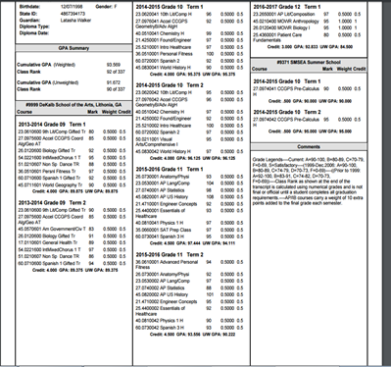
Understanding Your Transcript
The academic transcript will show student
coursework for all 4 years
The transcript will post only semester grades
T1 = Semester One, and T2 = Semester 2 grades
H=Honors Course: AP=Advanced Placement
Courses T/TR=Transfer Grades
NGE= No Grade Earned- Appears when the student has not taken the EOC test for the corresponding course.
Graduation Requirements/Progress - will be
monitored by you & your counselor-so keep
track of what you need to take!
Cumulative Data – All your credits are added,
your semester grades are averaged , and you are
ranked amongst your classmates here.
Your Name
Date of Birth
Guardian
Address

Slide 4


Understanding Your Transcript
Important to Know
Colleges will first look at overall GPA – students must study hard to raise your grades!
Colleges will next look at the rigor/difficulty of classes – students challenge themselves!
Colleges will look for patterns/improvements – so continue to get better!
Students are more than a transcript – get involved in extracurricular activities so that colleges can
see involvement on campus, leadership, teamwork, dependability, etc.
Failures are NOT replaced when students do recovery work, they still remain on the transcript, so
encourage them to do all the right things to never get one in the first place!

Slide 5
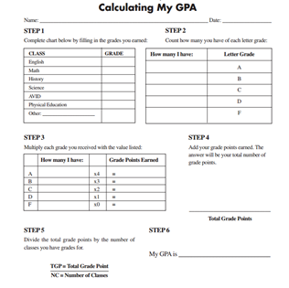


Calculate My GPA

Slide 6

www.parchment.com

